Slide 1



AcF 304 Financial Markets
Topic 5 – The Foreign Exchange Market
Part 3 – FX in The Short Run – The Practice
Notes:
If this PowerPoint presentation contains mathematical equations, you may need to check that your computer has the following installed:
1) MathType Plugin
2) Math Player (free versions available)
3) NVDA Reader (free versions available)

Slide 2
Exchange Rates in the Short Run (1 of 3)
Changes in domestic interest rates are often cited in the press as affecting exchange rates.
In the short run, it is the interest rate on domestic bank deposits in terms of foreign bank deposits that is important.
FX transactions in the US each year are 25 times the amount of US imports and exports. In short-run, decisions to hold US or foreign assets have a much greater influence on FX rates than demand for exports / imports

Slide 3
Exchange Rates in the Short Run (2 of 3)
If non-US investors (i.e. every investment manager in the UK !!!) wants to buy US stocks they need to Sell GBP/Buy USD
If non-US Central Banks want to buy US Government Bonds – they need to Sell XXX / Buy USD to do so!
Interest rates offered to investors in any country are key for currency flows!

Slide 4
Exchange Rates in the Short Run (1 of 3)
Scenario 1
EUR bank 12-month deposit rates = 2%
US bank 12-month deposit rates = 2%
EUR/USD =1.00
Scenario 2
EUR bank 12-month deposit rates = 2%
US bank 12-month deposit rates = 12%
As a European investor seeking returns, what will you do?
Sell EUR / Buy USD
Deposit those $ in US bank accounts
EUR weakens / USD strengthens

Slide 5
Applications
Our analysis also allows us to take a look at the weak dollar in the 1980s, and (partially) explain why it became stronger in the 1990s and 2000s. We present a summary in Figure 15.8, on the next slide.

Slide 6
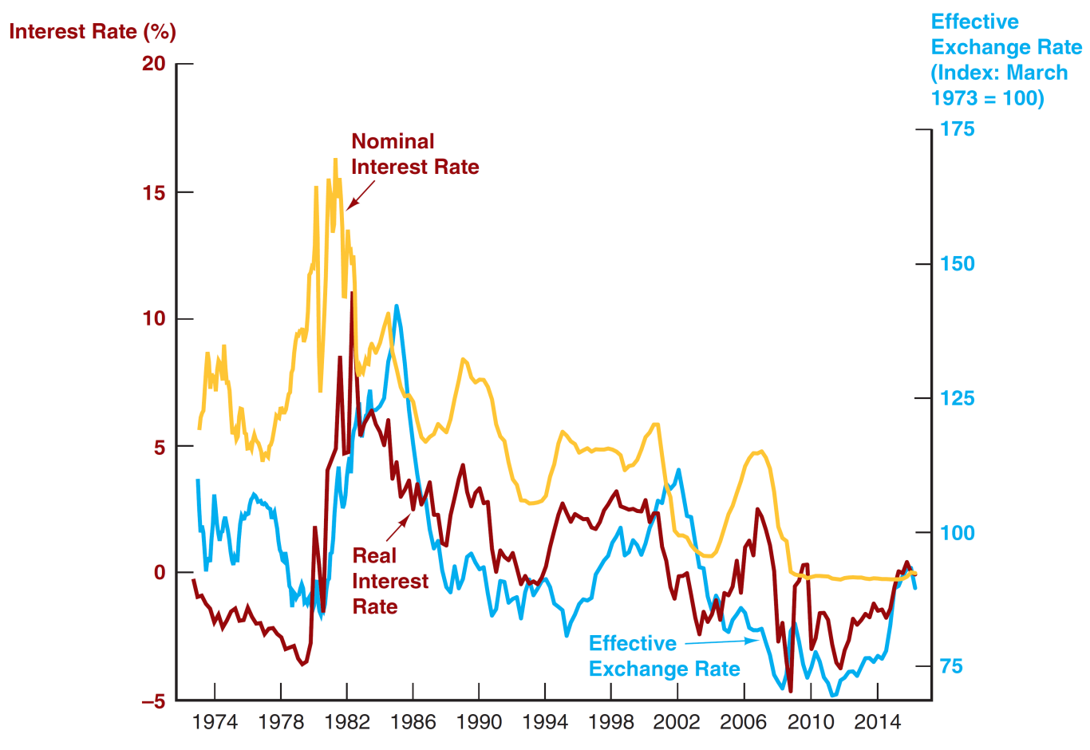
Figure 15.8 Value of the Dollar and Interest Rates, 1973–2016
Source: Federal Reserve Bank of St. Louis FRED database: https://fred.stlouisfed.org/series/TWEXMMTH; https://fred.stlouisfed.org/series/TB3MS; real interest rate from Figure 3.1 in Chapter 3.

Slide 7
Why Are Exchange Rates Important?
When the currency of your country appreciates relative to another country, your country’s goods prices increase abroad and foreign goods prices cheapen in your country.
Makes domestic businesses less competitive
Benefits domestic consumers (you)
Note: We look at all such practical and theoretical concepts from the point of view of the price of consumer goods e.g. a US car manufacturer selling a car in the US v. Europe
Let’s not complicate things at this stage by considering a US car manufacturer sourcing supply / car parts from overseas.

Slide 8
Why Are Exchange Rates Important?
When the currency of your country appreciates relative to another country, your country’s goods prices increase abroad
From a US perspective.
1 GBP = 2 USD
A ‘state of the art’ Tesla car that is available for sale will sell for USD 200,000 in the US or GBP 100,000 in the UK (Tesla receives the same USD revenue).
1 GBP = 1 USD (Sterling has weakened / Dollar strengthened)
How many pounds do I now need to buy a USD 200,000 car?
Answer GBP 200,000
When the currency of your country appreciates relative to another country, your country’s goods prices ↑ abroad.
Dollar strengthened>Dollar goods became more expensive in the UK/Europe.

Slide 9
Why Are Exchange Rates Important? (1 of 2)
When the currency of your country appreciates relative to another country, your country’s goods prices ↑ abroad and foreign goods prices ↓ in your country.
From a US perspective
1 GBP = 2 USD
A Rolls Royce car that costs GBP 100,000 in UK will cost USD 200,000 in US.
1 GBP = 1 USD (Sterling has weakend / Dollar strenthened)
A Rolls Royce car that costs GBP 100,000 in UK will now only cost USD 100,000 in US.
Strenthening currency benefits domestic (US) consumers (you) i.e. it makes imports cheaper!
Benefits domestic consumers (you)

Slide 10
Question
5) A stronger dollar benefits ________ and hurts ________.
A) American businesses; American consumers
B) American businesses; foreign businesses
C) American consumers; American businesses
D) foreign businesses; American consumers
Stronger Dollar = Weaker GBP
You need less USD to buy GBP goods
So cheaper for American consumers to buy UK goods
So benefits American consumers
You need more GBP to buy the same amount of USD goods.
So harder for Amercan business to export to UK (hurts American businesses)
Benefits American consumers; Hurts American export businesses
Answer: C

Slide 11
Question
5) Increased demand for a country's ________ causes its currency to appreciate in the long run, while increased demand for ________ causes its currency to depreciate.
A) imports; imports
B) imports; exports
C) exports; imports
D) exports; exports
Answer: C
Increased demand for a country’s exports e.g. US exports, means overseas countries need to sell their own currency e.g. EUR and buy USD. Demand for USD causes its price to go up / appreciate.
Increased US demand for imports means US customers need to sell USD and buy e.g. EUR causes the USD price to go fall / depreciate.
Benefits domestic consumers (you)

Slide 12
Question
When the exchange rate for the euro changes from EUR/USD 1.00 to EUR/USD 1.20, then, holding everything else constant, the euro has
A) appreciated and German cars sold in the United States become more expensive.
B) appreciated and German cars sold in the United States become less expensive.
C) depreciated and American wheat sold in Germany becomes more expensive.
D) depreciated and American wheat sold in Germany becomes less expensive.
Answer: A
break

Slide 13
Why Are Exchange Rates Important? (1 of 2)
23) If the dollar depreciates relative to the Swiss franc,
A) Swiss chocolate will become more expensive in the United States.
B) American computers will become less expensive in Switzerland.
C) Swiss chocolate will become cheaper in the United States.
D) both A and B of the above will happen.
Answer: D
Dollar depreciate, Swiss Franc strengthen.
You need more USD to buy CHF (chocolate) – A is correct
You need less CHF to buy USD (computers) – B is correct
Benefits domestic consumers (you)

Slide 14
Question:
5) When the value of the British pound changes from GBP/USD 1.50 to GBP/USD 1.25, the pound has ________ and the dollar has ________.
A) appreciated; appreciated
B) depreciated; appreciated
C) appreciated; depreciated
D) depreciated; depreciated
Answer: B
GBP/USD means dollars per pound.

Slide 15
AcF 304 Financial Markets
Topic 5 – The Foreign Exchange Market
Topic 6 – FX Spot Trading
Notes:
If this PowerPoint presentation contains mathematical equations, you may need to check that your computer has the following installed:
1) MathType Plugin
2) Math Player (free versions available)
3) NVDA Reader (free versions available)

